Slide 1
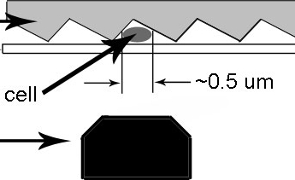
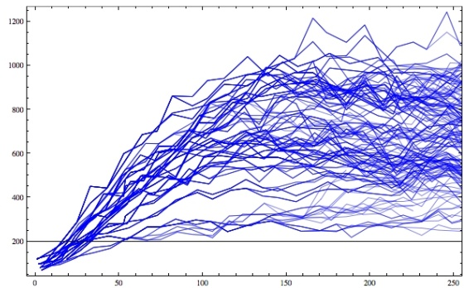
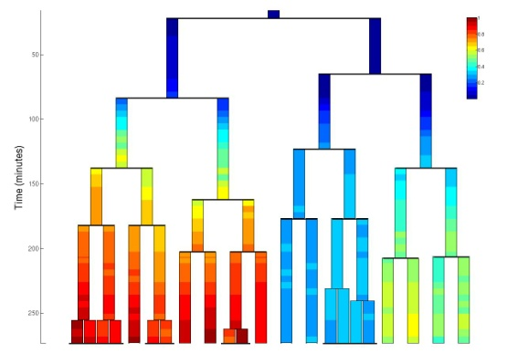
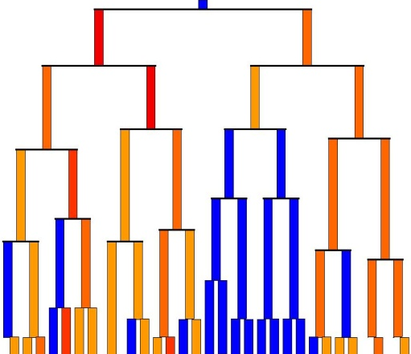
Figure 1
A
B
C
D
Fluorescence
Time
E
Pmar
marR
marA
marB
Pacr
acrA
acrB
Inducer
Efflux Pumps

Slide 2
Figure 2
A
B
Time
[YFP]
CV
μm
Salicylate [mM]
C
mar induction
Time (min)

Slide 3
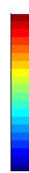
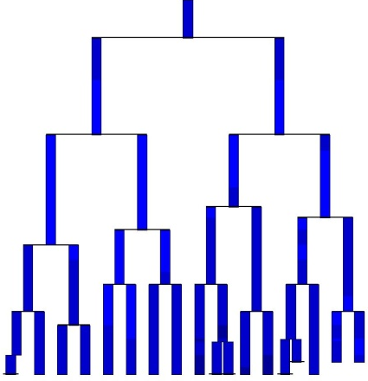
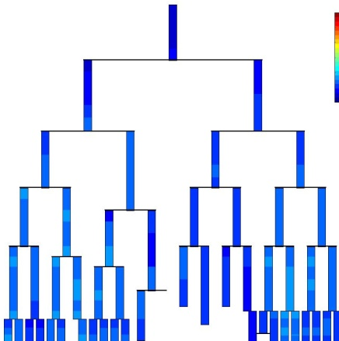
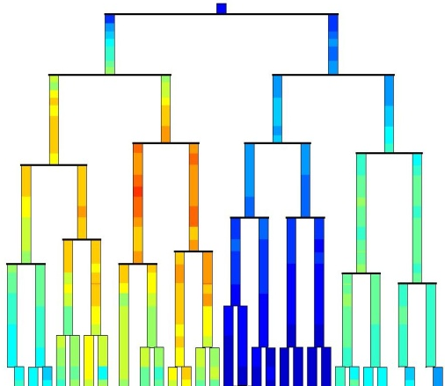
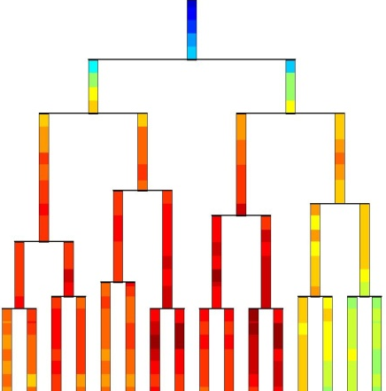
Figure 3
A
[YFP]
time
(min)
0 mM
[salicylate]
0.25 mM
[salicylate]
1 mM
[salicylate]
3 mM
[salicylate]
1200
1000
800
600
400
200

Slide 4
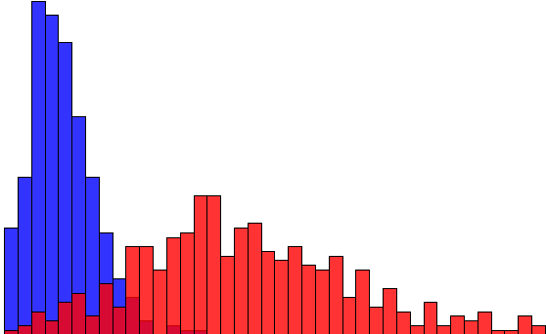
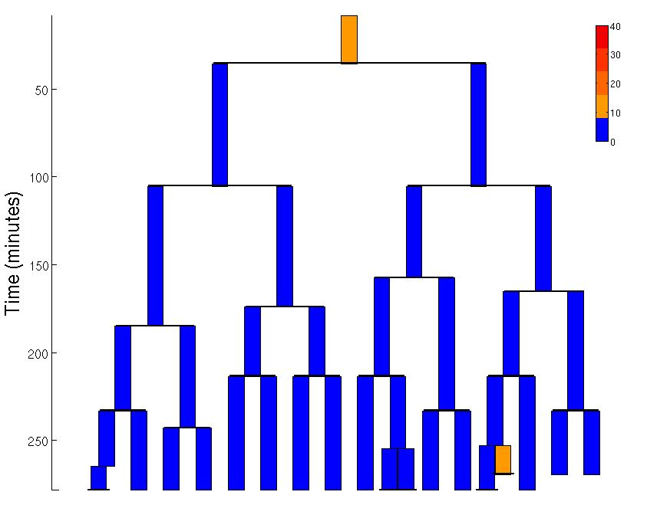
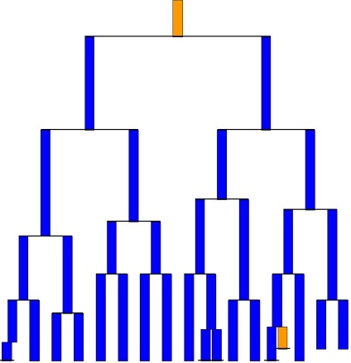
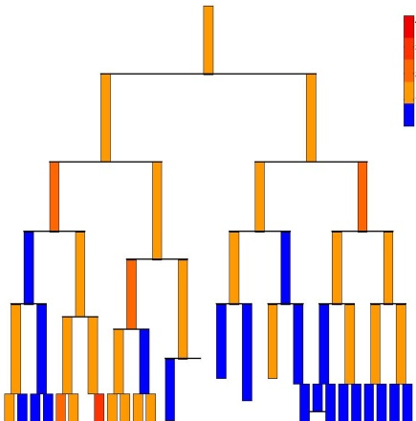
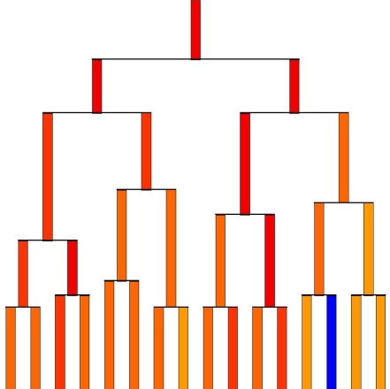
Figure 3
B
[salicylate]
0mM
Number of cells
3mM
Promoter activity (a.u.)
C
Activity
time
(min)
0 mM
[salicylate]
0.25 mM
[salicylate]
1 mM
[salicylate]
3 mM
[salicylate]
40
30
20
10

Slide 5
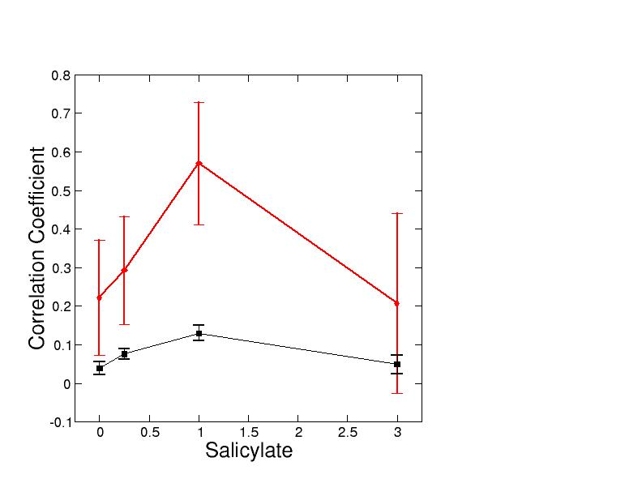
Figure 4
A
100
80
60
B
Domain size
40
20
0
0
1
2
3
Salicylate [mM]

Slide 6
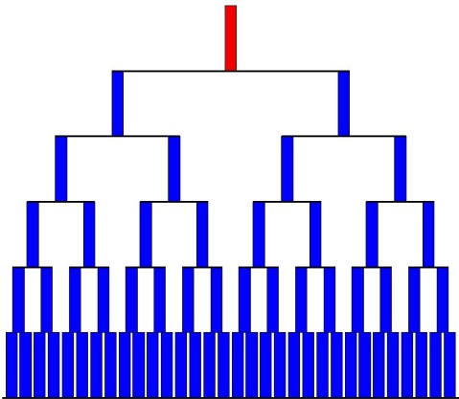
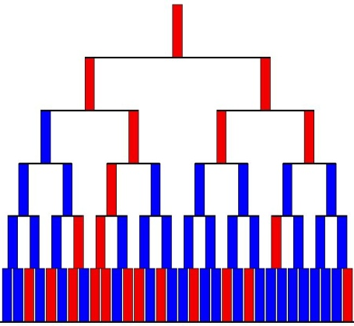
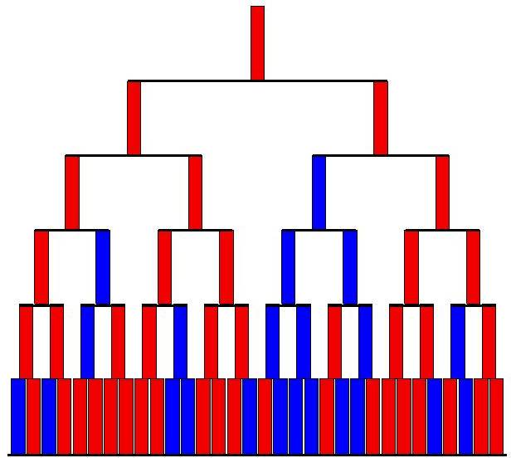
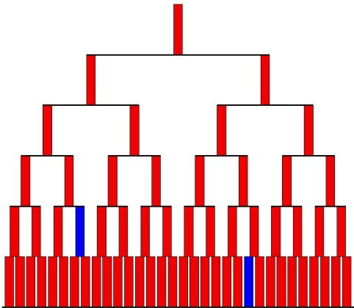
Figure 5
A
0 mM
[salicylate]
0.25 mM
[salicylate]
1 mM
[salicylate]
3 mM
[salicylate]
P(on|off) = 0.06
P(off|on) = 0.89
P(on|off) = 0.39
P(off|on) = 0.30
P(on|off) = 0.54
P(off|on) = 0.18
P(on|off) = 0.79
P(off|on) = 0.10
B
Domain size
Salicylate [mM]

